Slide 1

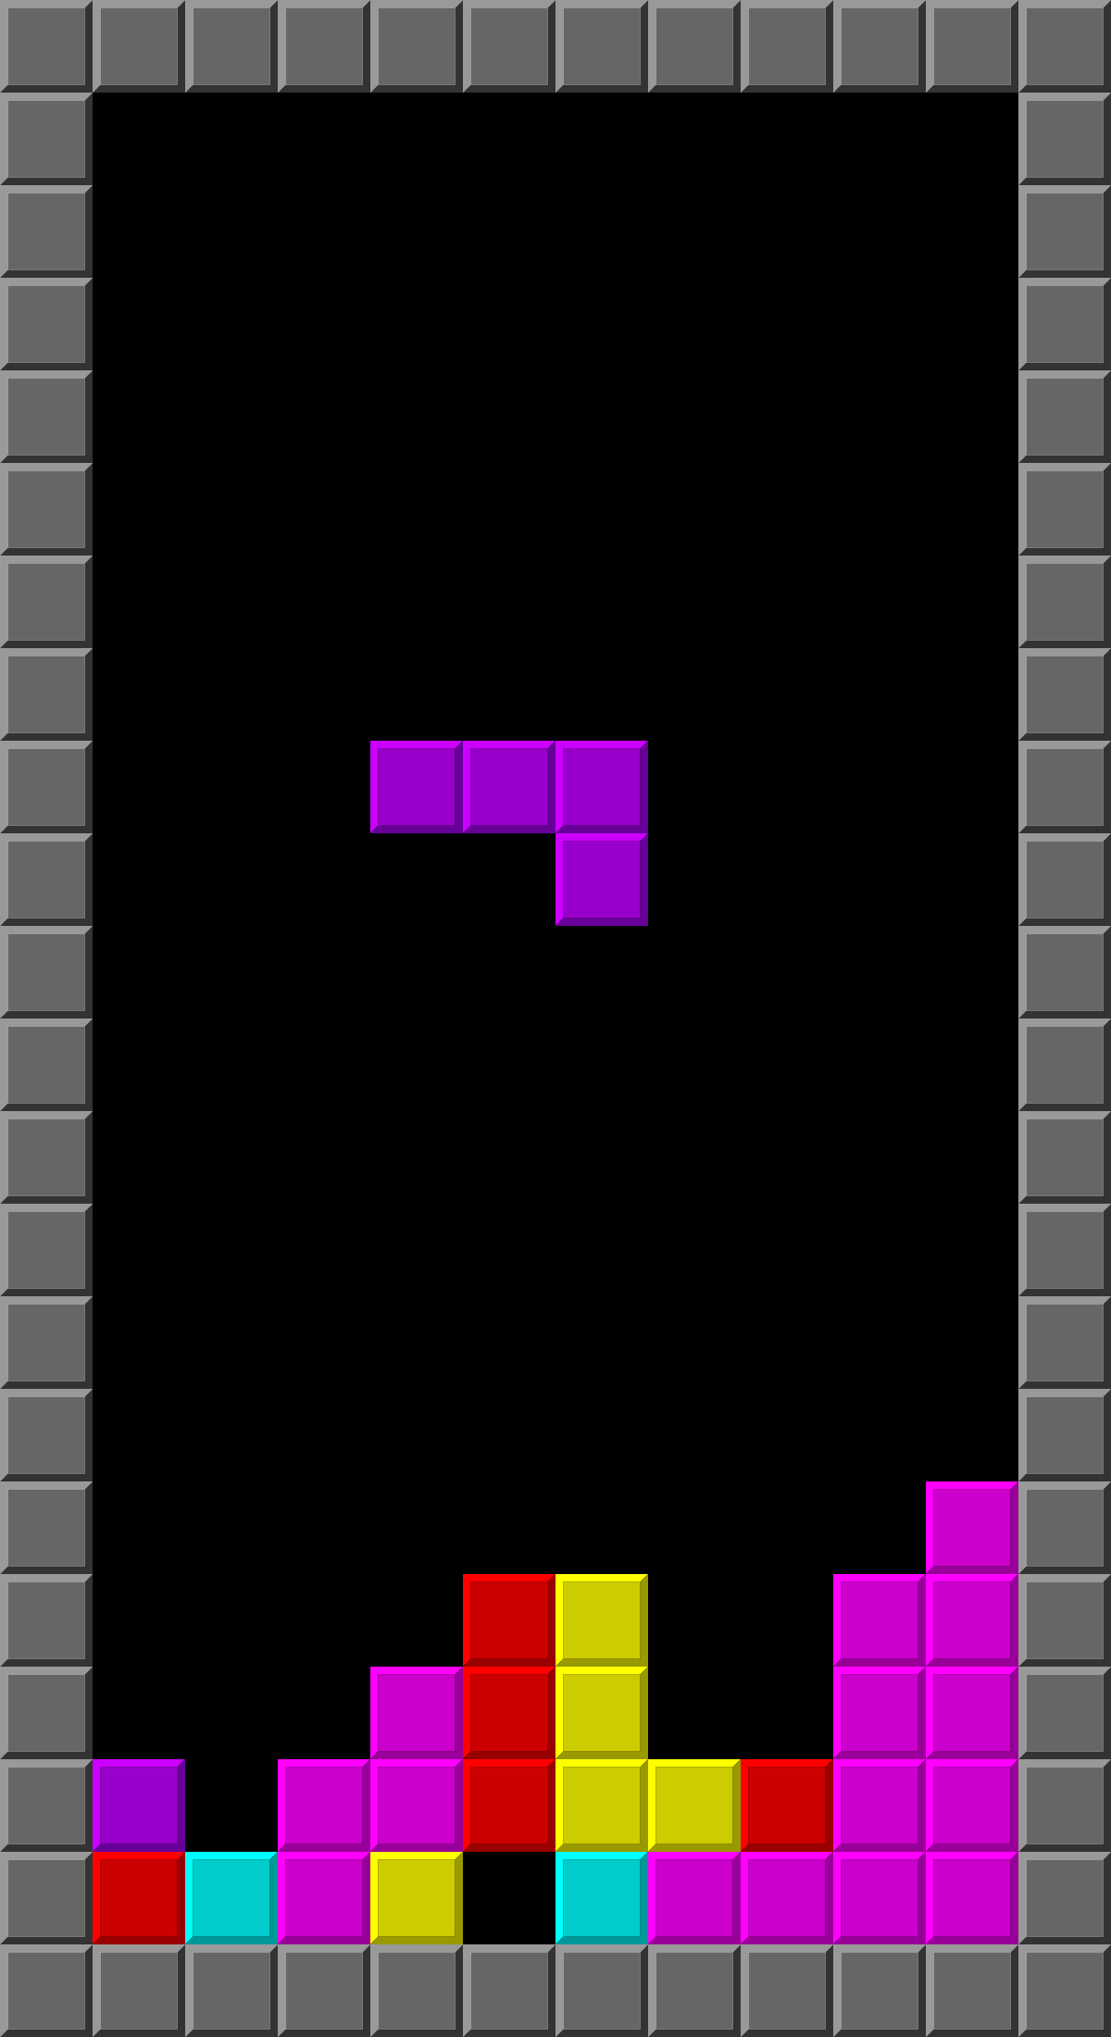
Tetris X
Project Release Plan
July 3rd, 2017
Team name: Spirit
Team member names:
Jiaming Zhao (Product Owner)
Yilin Xu (initial Scrum Master)
Xuanyi Zhang
Weiyi Xia

Slide 2
Android Tetris game
Project Release Plan
High level goals:
- a functional Tetris game
- Tetris with difficulty level selections
- users be able to login in the game
- users be able to view their online ranking

Slide 3
Tetris X – Beta 1.0
Project Release Plan – User Stories
Sprint 1:
- sign up function
- database to store information
- working Tetris game

Slide 4
Tetris X – Beta 1.0
Project Release Plan – User Stories
Sprint 2:
- difficulty selection function
- difficulty levels differ on:
block falling speed
generate location
game scores

Slide 5
Tetris X – Beta 1.0
Project Release Plan – User Stories
Sprint 3:
- online ranking function
- switch account function
- completely functional game

Slide 6

Tetris X – Beta 1.0
Project Release Plan – Architecture
Overall structure
Database

Slide 7
Tetris X – Beta 1.0
Project Release Plan – Challenges/Risks
Challenge
1: request and send information between the phone and the database
2: Merging code on Android studio
3: Functional game without bugs

Slide 8
Tetris X – Beta 1.0
Project Release Plan – Technologies
Technologies:
- Coding platform: Android Studio
- Database: Firebase web server
- Hardware: Android phones

